Slide 1
LED Technology and Our Schools:
The Technology, The Applications, The Business Case
John M. Busch, LEED GA
CASDEM March 5th 2015

Slide 2
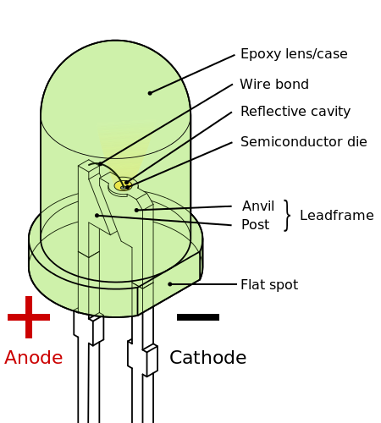
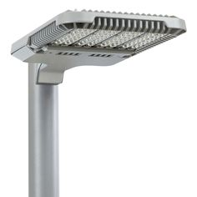
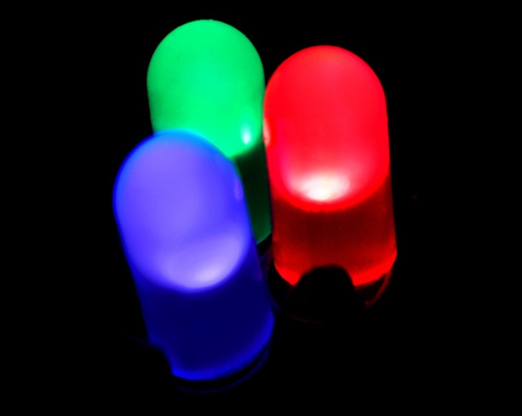
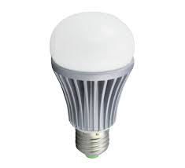
The Technology of Light Emitting Diodes (LEDs)
Electroluminescence first detected in 1906
First LEDs developed in 1951 (back lighting, small indicator lighting)
Area, task, and general lighting by LEDs came in 1990s
Unreliability in first generations, heat sync problems, bad drivers, etc.
Many generations of LED technology in 2014

Slide 3
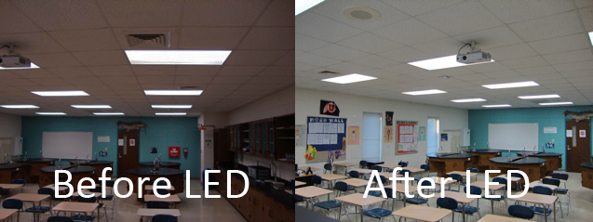
The Benefits of LED Lighting in Schools
Improved light quality and uniformity
Adjustable LED color & temp aligns with body’s natural cycles for improved student performance
Campus safety, color rendering, security systems
Energy & operational savings
Higher efficacy delivers IES standards more efficiently
Total cost of ownership less compared to fluorescent

Slide 4
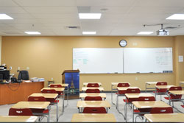
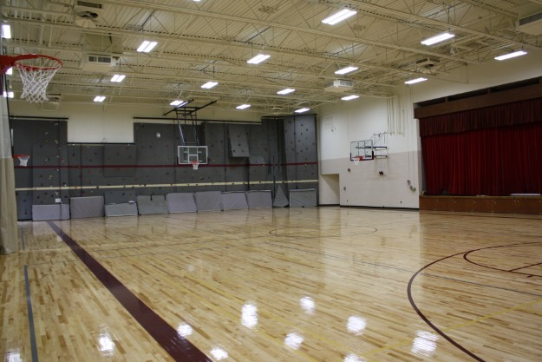
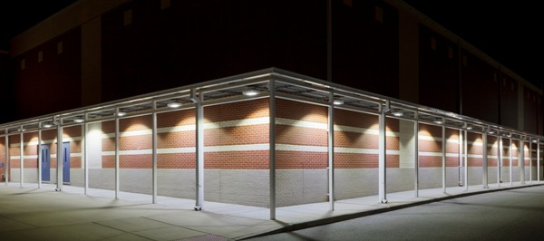
Areas of Application for LED
Classrooms/Hallways/Offices
Gymnasiums
Exterior/Area/Parking

Slide 5
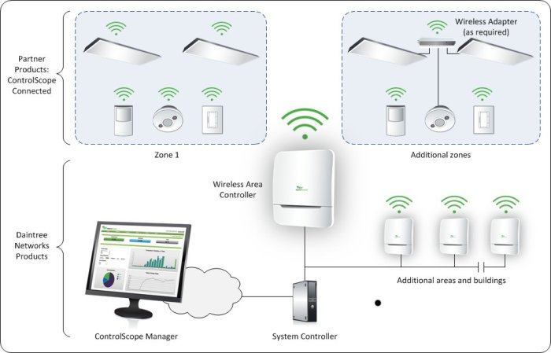
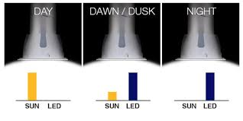
LEDs and Controls
LED lend themselves to controllability
Trend towards smart, networked fixtures
Additional energy savings
Daylighting, occupancy, etc.

Slide 6
Evaluating LED Lighting Upgrades
Old luminaire
Including ballasts & lamp(s)
New lamp(s)
New lamp(s) & ballasts
New luminaire system
New system including controls
System energy usage
Inefficient (red)
Efficient (green)
Total Potential Savings in US from Lighting Upgrades:
$18 Billion
158 Million Tons of CO2
192 Power Stations @ 2 TWhr/yr
6
Notes:
Let’s start with the savings.
This graph depicts how cities and facilities attempt to capture the energy savings that come with lighting upgrades.
If you start with an old, inefficient lighting system and upgrade to new bulbs – or new ballasts and bulbs – you will start to see your energy usage go down and begin to earn a return on your investment.
Upgrading to a new lighting system will provide even more energy savings and a higher return on investment.
And upgrading to new LED technology in combination with controls will allow your city and facilities to realize even more significant benefits , cutting your energy usage in half while reducing greenhouse gas emissions.
In fact, a recent study sponsored by Philips, the Climate group and HSBC on “Lighting the Clean Revolution” summarized pilot projects in 12 of the world’s largest cities and found the potential for 85% in energy savings from transitioning to LED lighting.
So let’s discuss the very real savings and other benefits other US cities have seen from their Philips lighting installations .

Slide 7
Business Case & Financial Merits
Comparing Operating Costs
Fluorescent vs LED
Assumed $0.075/kWh
*Assumed spend of $5/fixture (maintenance) on fluorescent per year
Assume 12 hrs per day operation

Slide 8
Projected Operating Costs & Savings

Slide 9
Material Payback Analysis

Slide 10
Thank You
John M. Busch
(720)525-9080
John.busch@philips.com

